Slide 1

EMPLOYEE DATA ANALYSIS USING EXCEL
STUDENT NAME : YAMUNA G
REGISTER NO : 3039FC9AB78935695EC4A270BB8C0930,312208818
DEPARTMENT : B.COM (GENERAL)
COLLEGE : MEENAKSHI COLLEGE FOR WOMEN

Slide 2
PROJECT TITLE
.
EMPLOYEE PERFORMANCE ANALYSIS
BASED ON DEPARTMENT ,EMPLOYEE TYPES,AND SALARY.

Slide 3


AGENDA
PROBLEM STATEMENT
PROJECT OVERVIEW
END USERS
4.OUR SOLUTION AND PROPOSITON
5.DATASEY DESCRIPTION
6.MODALLING APPROACH
7.RESULTS AND DISCUSSION
8.CONCLUSION

Slide 4

PROBLEM STATEMENT
DIFFERENCES IN COMPENSATION BETWEEN TEMPORARY ,FIXED AND PERMANENT EMPLOYEES, POTENTIALLY LEADING TO ISSUES WITH FAIRNESS AND LOYALTY.
SIGNIFICANT DISPARITIES IN SALARIES FOR SPECIALIZED TECHNICAL ROLES COMPARED TO LESS SPECIALIZED POSITIONS.

Slide 5

PROJECT OVERVIEW
BY ADDRESSING THESE DEPARTMENTAL SALARY ISSUES, ORGANIZATIONS CAN IMPROVE FAIRNESS, ENHANCE EMPLOYEE SATISFACTION, AND BETTER ALIGN COMPENSATION WITH ROLES AND RESPONSIBILITIES.
EMPLOYEE ANALYSIS INVOLVES EXAMINING VARIOUS ASPECTS OF THE WORKFORCE TO GAIN INSIGHTS THAT CAN HELP IN DECISION - MAKING, AND ENHANCING EMPLOYEE SATISFACTION.

Slide 6

WHO ARE THE END USERS?
MANAGERS
TEAM LEADERS
EXECUTIVES
SUPERVISORS
FINANCE ANALYSTS
ADMINISTRATIVE OFFICER
HUMAN RESOURCES DEPARTMENTS
EMPLOYEES

Slide 7

OUR SOLUTION AND ITS VALUE PROPOSITION
PIVOT TABLE – SUMMARY OF EMPLOYEE PERFORMANCE
BAR DIAGRAM – FINAL REPORT

Slide 8
Dataset Description
EMPLOYEE DATA SET - NAN MUDHALVAN PORTAL
9 FEATURES IN EXCEL:
EMPLOYEE ID - ALPHANUMERIC(TEXT)
NAME - ALPHABETICAL (TEXT)
GENDER - ALPHABETICAL (TEXT)
DEPARTMENT - ALPHABETICAL(TEXT)
SALARY - NUMERICAL
START DATE - ALPHANUMERIC(TEXT)
FTE - NUMERICAL
EMPLOYEE TYPE - ALPHABETICAL (TEXT)
EMPLOYEE LOCATION - ALPHABETICAL (TEXT)
3 FEATURES USED:
DEPARTMENT - ALPHABETICAL(TEXT)
SALARY - NUMERICAL
EMPLOYEE TYPE - ALPHABETICAL(TEXT)

Slide 9

THE "WOW" IN OUR SOLUTION
ADDRESSING THE SALARY DISPARITIES HIGHLIGHTED BY THIS ANALYSIS IS ESSENTIAL FOR FOSTERING A FAIR AND MOTIVATING WORK ENVIRONMENT.
BY IMPLEMENTING THE RECOMMENDED CHANGES, THE ORGANIZATION CAN ENHANCE EMPLOYEE SATISFACTION, ATTRACT TALENT, AND ENSURE A MORE EQUITABLE COMPENSATION SYSTEM.
9

Slide 10
MODELLING
STEP-1
DOWNLLOAD THE EMPLOYEE DATASET AND OPEN THE
EMPLOYEE DATASET IN EXCEL.
STEP-2
SELECT THE ENTIRE DATA AND CLICK ON INSERT AND
CLICK ON PIVOT TABLE TO CREATE PIVOT TABLE.
STEP-3
DRAG THE NEEDED DATA AND CREATE A PIVOT TABLE.
STEP-4
SELECT THE PIVOT TABLE AND CLICK ON INSERT.
RESULTS TABLE.
STEP-5
NOW CLICK ON THE CHART THAT YOU WANT.
STEP-6
THE CHART IS CREATED.
10

Slide 11
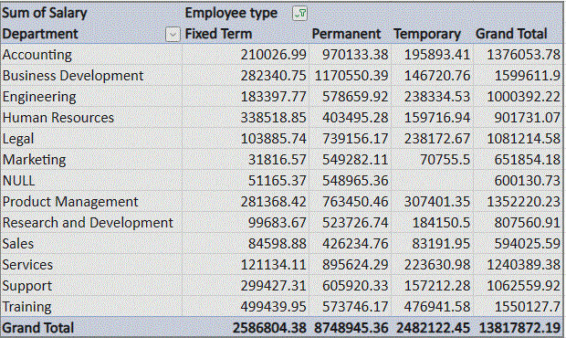
RESULTS
1.TABLE​
11

Slide 12
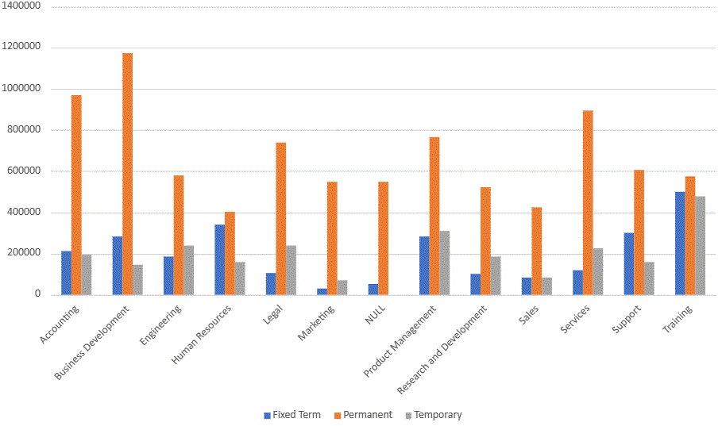
2.BAR DIAGRAM

Slide 13
CONCLUSION
THE DATA INDICATES SIGNIFICANT VARIATIONS IN AVERAGE SALARIES ACROSS DEPARTMENTS. FOR INSTANCE, DEPARTMENTS SUCH AS ACCOUNTING DEPARTMENT RECEIVES HIGHER SALARIES COMPARED TO THOSE IN SALES DEPARTMENT.
ANALYSIS COULD EXPLORE THE UNDERLYING FACTORS CONTRIBUTING TO THE OBSERVED SALARY DISPARITIES, SUCH AS DIFFERENCES IN JOB RESPONSIBILITIES, MARKET DEMAND, AND DEPARTMENTAL BUDGETS. REGULAR REVIEWS AND UPDATES TO SALARY DATA WILL BE CRUCIAL IN MAINTAINING FAIRNESS AND COMPETITIVENESS.

